Slide 1
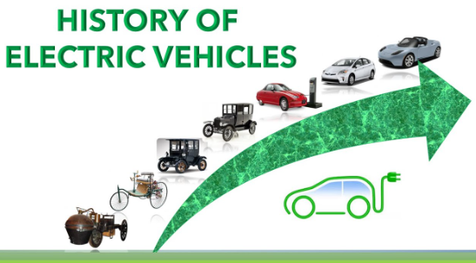
History of EV
1. In 1827 Anyos Jedlik built the first crude but viable electric motor, and next year he used it to a tiny car.
2. Between 1832-1835 Sibrandus Stratingh built a small-scale electric car.
3.Then in 1835-1840 Robert Anderson invented the first electric carriage vehicle using non rechargeable primary cells.
4. The first mass-produced electric vehicles appeared in 1902 by Studebaker Automobile Company but due to limitations of storage battery it did not gain much popularity.

Slide 2
Types of EV
Electric Vehicle
BEV PHEV HEV
(Battery Electric Vehicle)
It is 100% powered by electricity.
(Plug-in Hybrid Electric Vehicle)
This type of vehicles are
with an internal
combustion engine and a
battery charged from an
external plug or socket.
(Hybrid Electric Vehicle)
This type of vehicles are with an
electric battery that is charged using
the internal combustion engine, don't
have an plug or socket.

